Slide 1
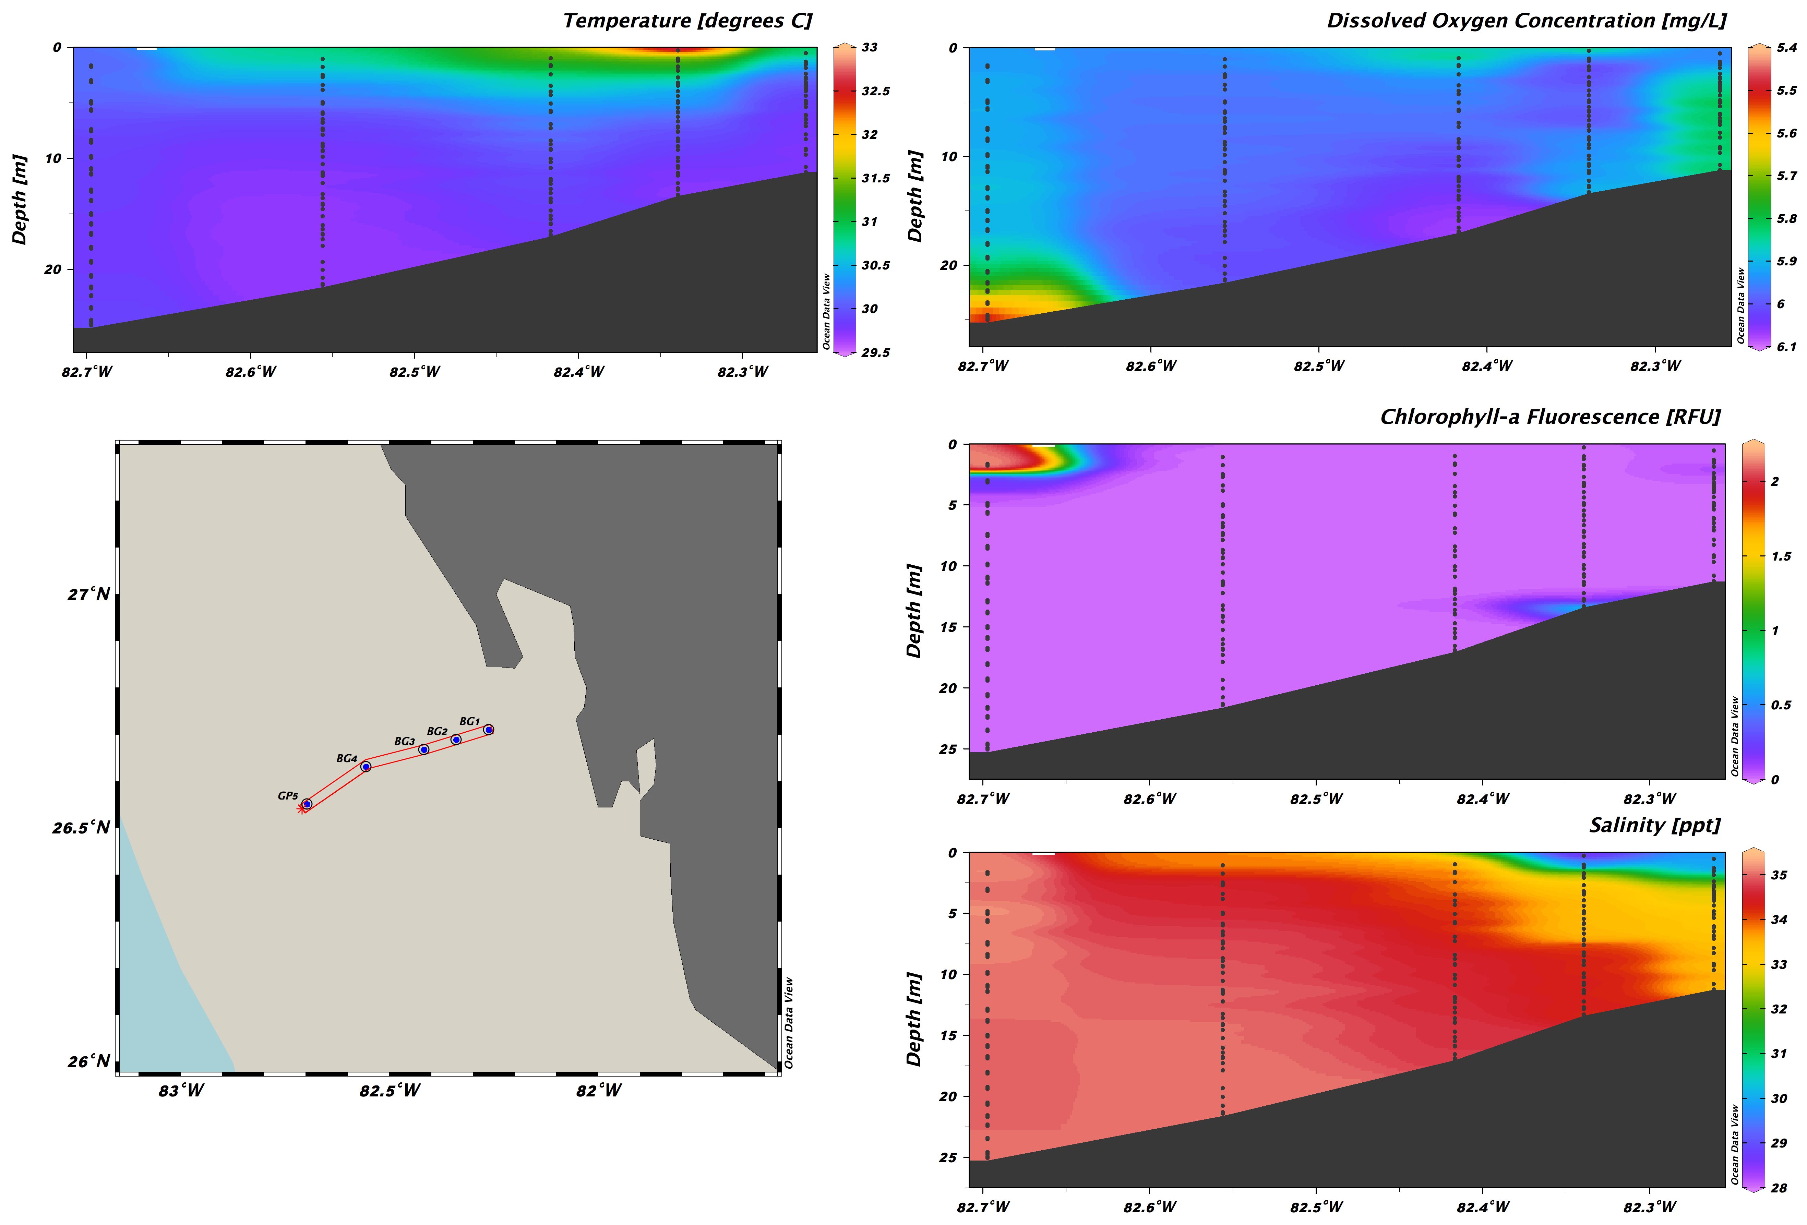


Collaborating with commercial fishermen to fill critical offshore data gaps

